Slide 1

Project

Slide 2

Chronic Care Analytics For tracking and analyzing chronic disease data. Presented By Nicollette Mtisi Ruvarashe C Mabika Sharman T Koropa

Slide 3

Business Problem
Chronic diseases such as diabetes, hypertension, asthma, and heart disease are on the rise, particularly in urban populations due to lifestyle factors, environmental stressors, and healthcare disparities.
Health organizations need a comprehensive system to track, analyze, and respond to chronic disease trends among urban residents.
Our proposed database solution will allow healthcare providers, researchers, and policymakers to track the diagnosis rates, treatment plans, hospital visits, medication usage, and outcomes of patients with chronic diseases.
This will support better resource allocation, preventive health programs, and targeted interventions to improve urban population health.

Slide 4
Business Problem Being Solved
Identify most prevelant diseases and their distribution helping to prioritize resources, research funding, and prevention campaigns:
Increase efficiency in resource allocations ensuring that high-need areas receive adequate attention
Manage Patient Cases: Maintain comprehensive patient records to streamline care and treatment.
Analyze and show real –world performance of medicine and show its effectiveness and guide future drug development.
Analyze Disease Patterns: Generate data-driven insights for better strategic planning and Chronic disease interventions.
This solution empowers healthcare organizations to improve chronic disease responses, mitigate outbreaks effectively, and enhance operational efficiency.

Slide 5
Main Entities in the Chronic Disease Model
Person - Stores information such as personal details and medical history.
Disease - Captures details about various diseases, including disease intensity level, type, and source.
Indication- Represents symptoms or indications related to diseases.
Medicine- Represents medications used to treat diseases.
Location- Represents geographical data related to patients or diseases..
Race - Represents different racial categories of individuals.
Race Disease Propensity - Represents the relationship between race and predisposition to certain diseases.
Diseased Patient - A junction or associative entity linking patients with diseases they have.
Disease Type - contains more information about the diseases.
Relationships
Person to Diseased Patient: A person can be associated with multiple diseases.
Disease to Indication: A disease can have multiple indications
.Medicine to Indication: Medicines may be prescribed based on specific indications.
Race to Race Disease Propensity: This can show how different races might have different propensities to certain diseases.

Slide 6
Data Dictionary
We used the same as Prof Strum’s model and also attached the data dictionary for the schema in a separate word document

Slide 7
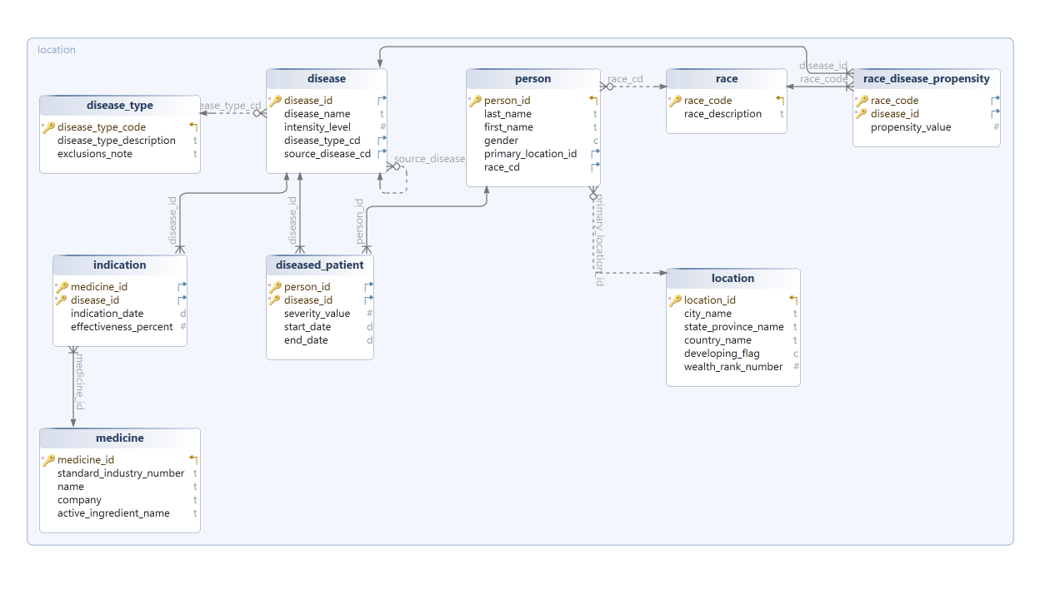
ER Diagram

Slide 8
Creating and Populating the OLTP Database
The purpose of this step is to implement a fully functional Online Transaction Processing (OLTP) database for the management system using PostgreSQL. The OLTP database is designed to handle daily operational tasks, such as tracking patient (person) cases, managing healthcare facilities, and monitoring medication performance, while ensuring fast and efficient querying of transactional data.

Slide 9
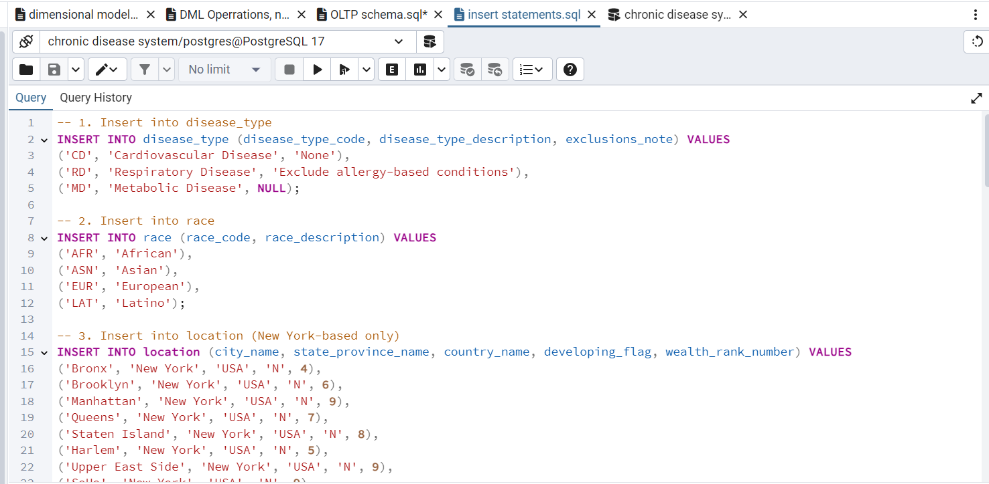
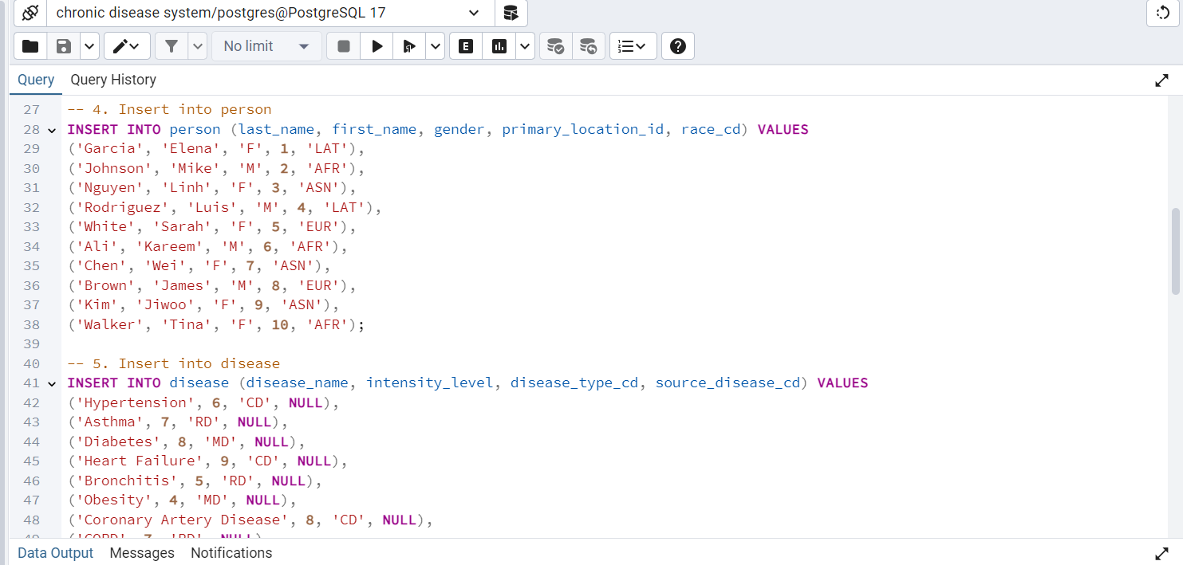
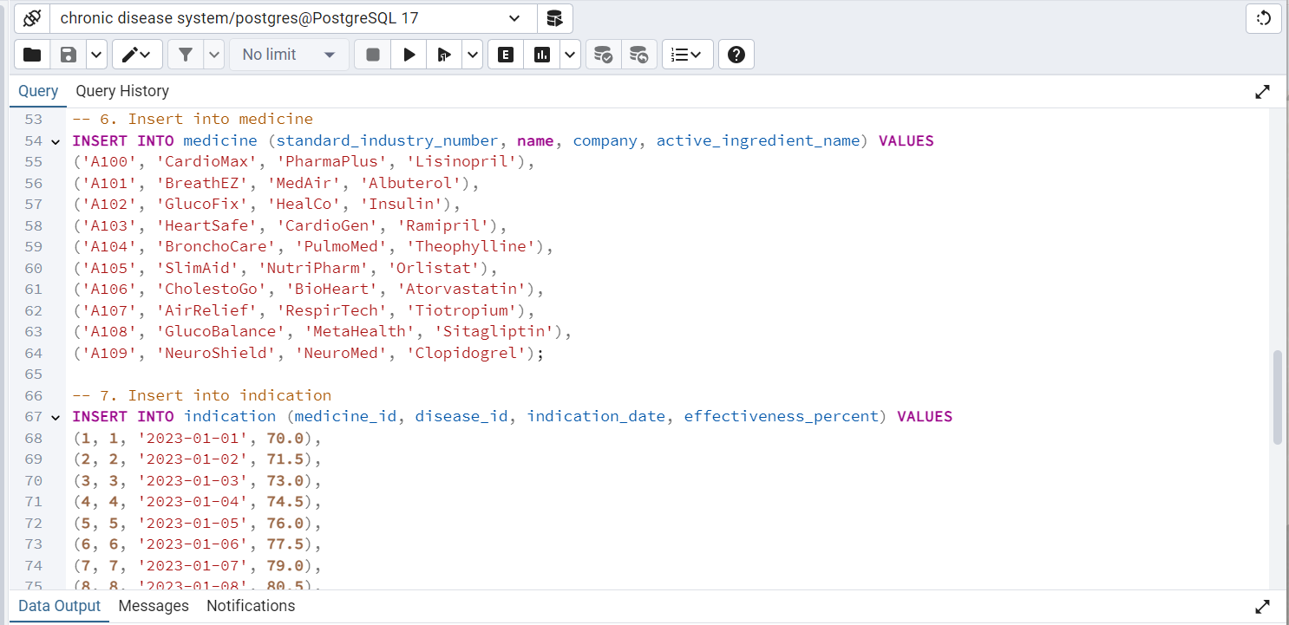
Data Population

Slide 10
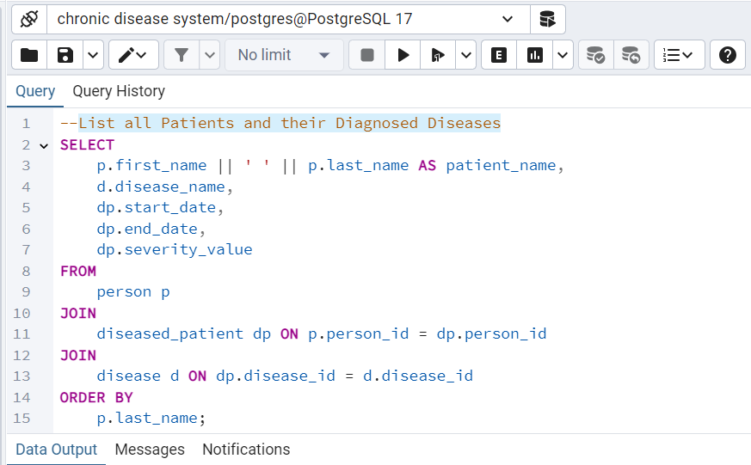
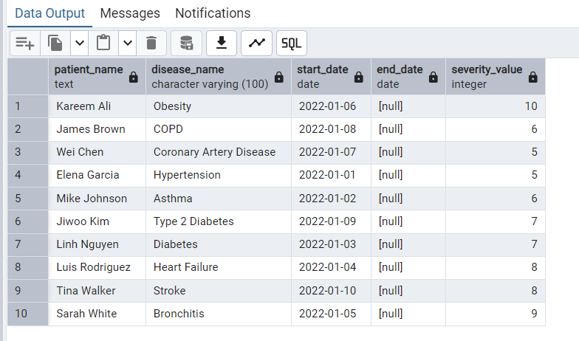
Query 1: List all Patients and their Diagnosed Diseases

Slide 11
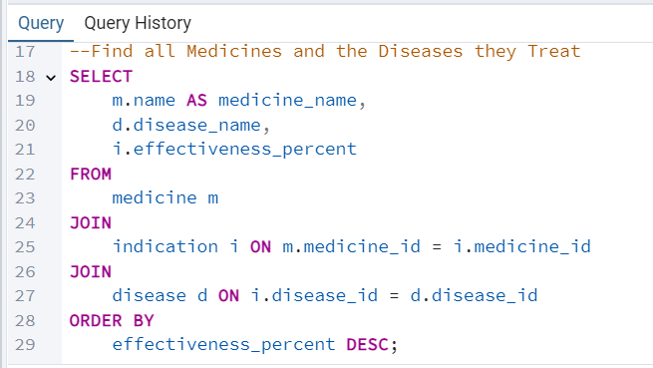
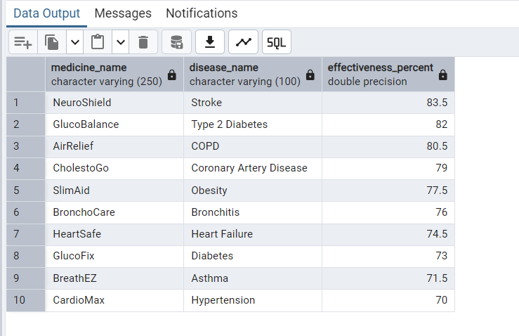
Query 2: Find all Medicines and the Diseases they Treat

Slide 12
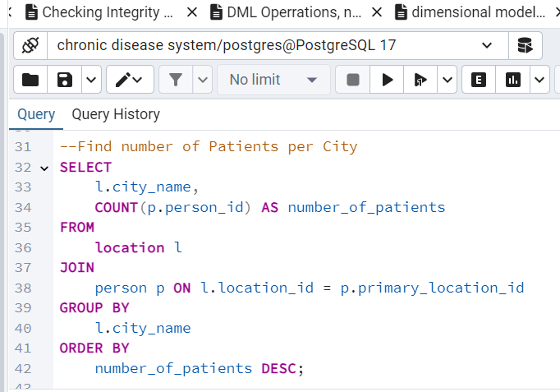
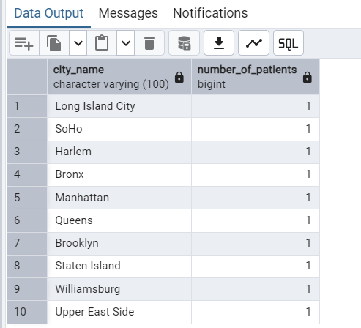
Query 3: Find number of Patients per City

Slide 13
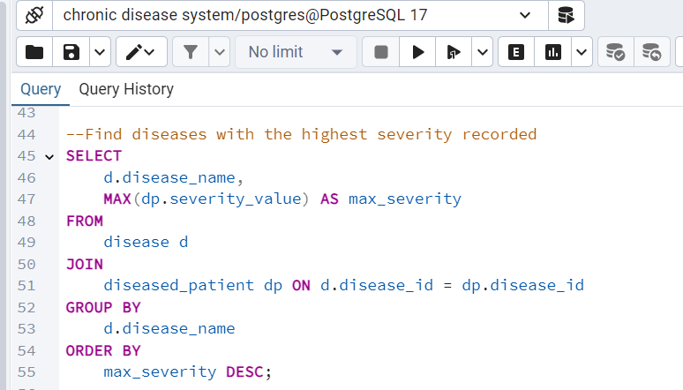
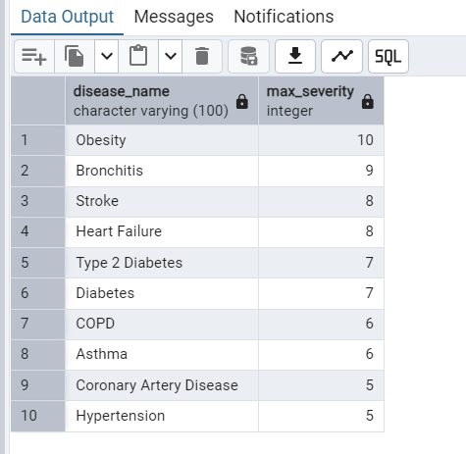
Query 4: Find diseases with the highest severity recorded

Slide 14
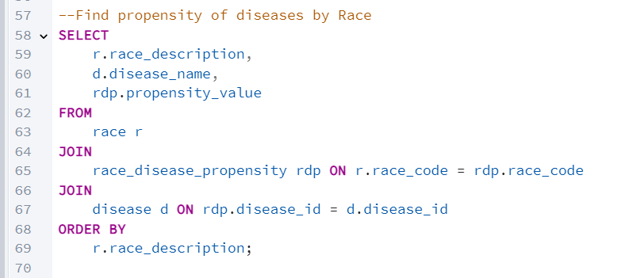
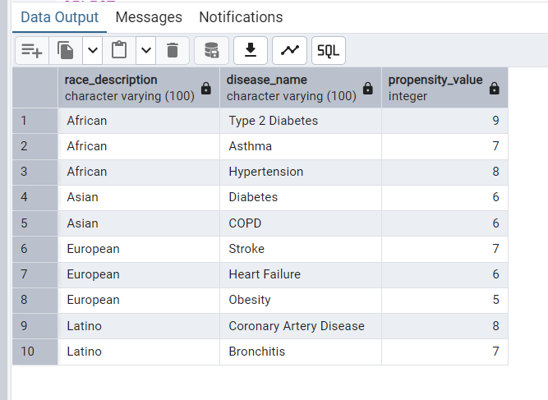
Query 5: Find propensity of diseases by Race

Slide 15
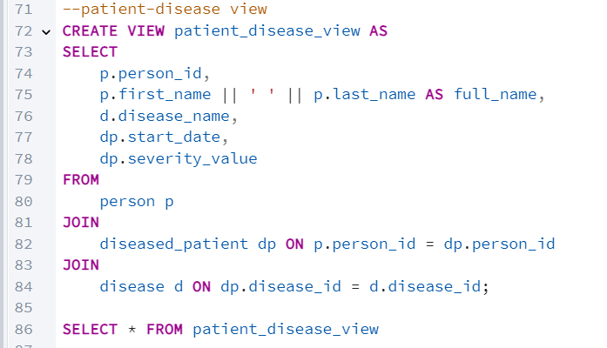
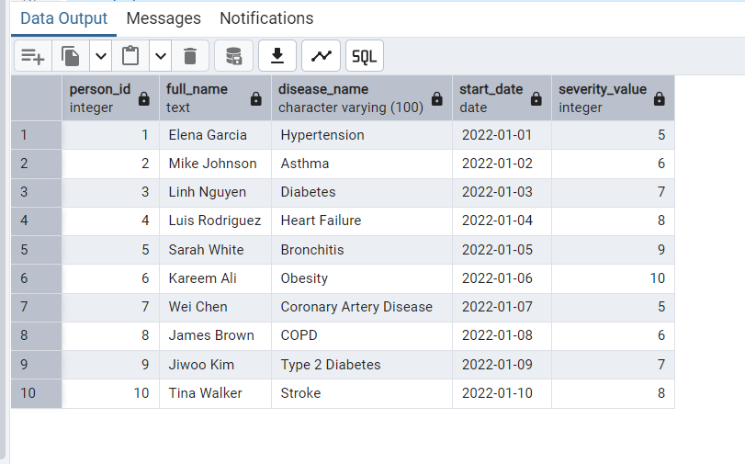
Query 6: Find propensity of diseases by Race

Slide 16
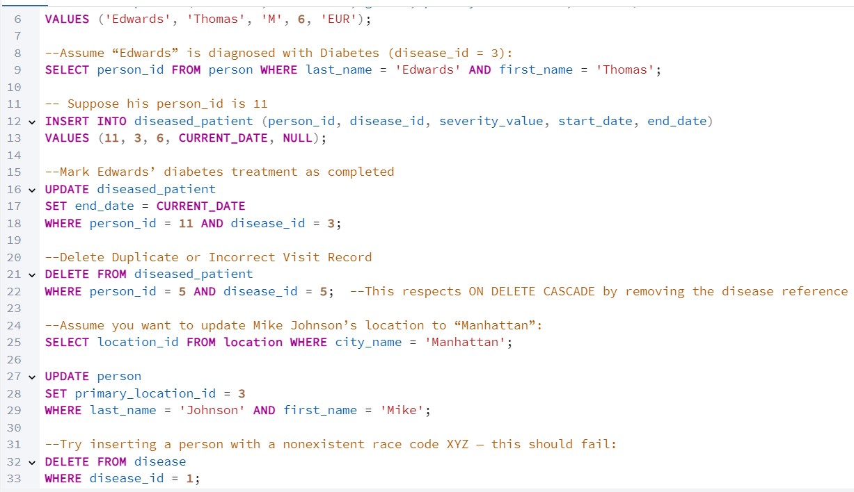
Checking Integrity constraints we inserted a new patient Edwards whose treatment was then completed so information was updated in the database. Also tried adding a person with a non existing race code so it failed.

Slide 17
Dimensional Database
Grain
The Person-Diagnosis-Date Level is the level of granularity in this disease data warehouse. Each record in the fact table represents a single disease diagnosis for a patient on a specific date, including details like disease type, severity, treatment used, and effectiveness.
Why Use the Person-Diagnosis-Date Grain?
Detailed Person Tracking: This level captures every individual test, enabling detailed tracking of patient histories, treatments, and test outcomes.
Disease Progression Monitoring: By keeping test data at this level, analysts can study disease progression patterns and treatment effectiveness over time.

Slide 18
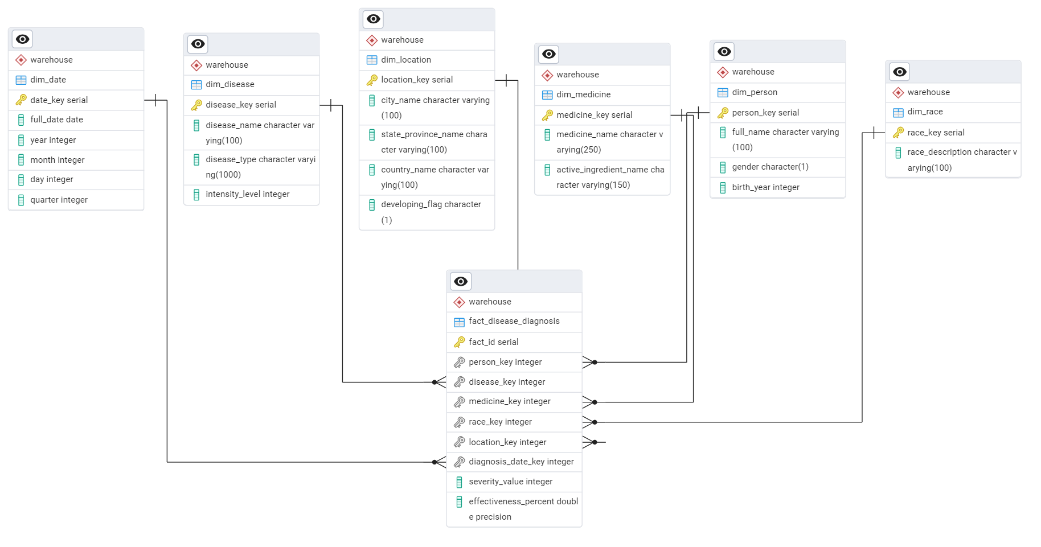
Dimension Tables

Slide 19
Fact Table (fact_disease_diagnosis)
This table’s primary grain is at the person, disease, date, medicine, race, location level — which means:
Each row represents one person’s diagnosis
for one disease
on one date
with one medicine
tied to one race and one location
including metrics like severity_value and effectiveness_percent
This fits perfectly with a patient-test or patient-diagnosis event-level grain.

Slide 20
Supporting Dimensions
dim_date → gives the date context (day, month, year, quarter)
dim_person → identifies the individual (gender, birth year)
dim_disease → specifies the disease, type, intensity
dim_medicine → captures medication details
dim_location → gives geographic context
dim_race → holds race/ethnicity context
These dimensions support the fact table’s grain because they describe each row.

Slide 21
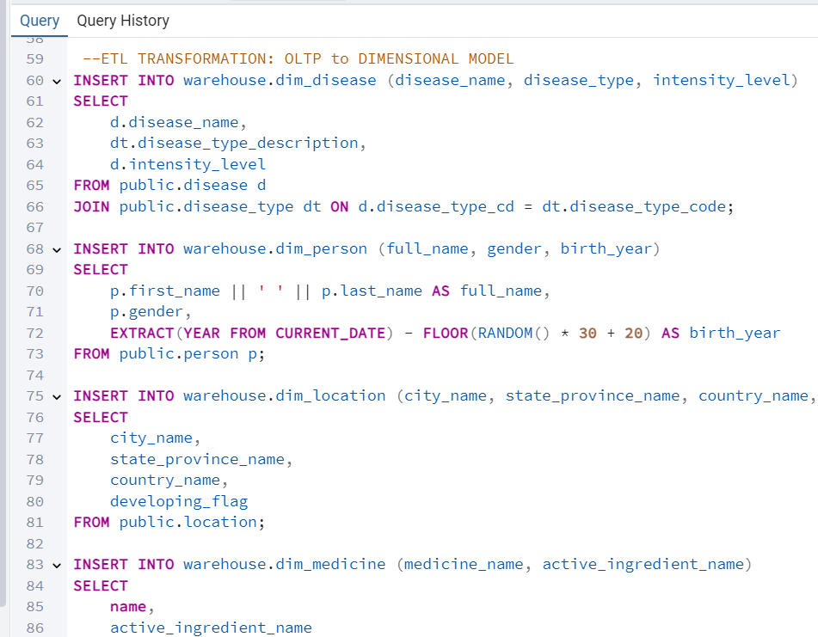
Populating the Dimensional Schema with data from OLTP

Slide 22
ELT Process — Loading from OLTP to Dimensional Model
Extract
We pulled the data from the OLTP schema (public), which included the detailed normalized tables like person, disease, medicine, location,
Load
We loaded the data into the new warehouse schema (inside the same Postgres database), which holds the dimensional model. This schema included:
fact_disease_diagnosis (fact table)
dim_disease, dim_person, dim_location, dim_medicine, dim_race, dim_date (dimension tables)
Transform
Using SQL scripts, we joined, enriched, and reshaped the data:
Matched keys between fact and dimension tables.
Cleaned up formats (like date keys, calculated birth years, joined names).
Handled missing or incomplete relationships with LEFT JOIN where appropriate.
Calculated aggregates like severity and effectiveness.
This process followed an ELT pattern because:
We loaded the raw data first into the warehouse.
Then we ran transformations inside the warehouse using SQL to prepare it for analytics.
This shift from OLTP to OLAP prepared the system for:
Fast, flexible analytical queries
Slicing and dicing across multiple business dimensions
Feeding data to a visualization tool (Tableau) for dashboards and reports

Slide 23
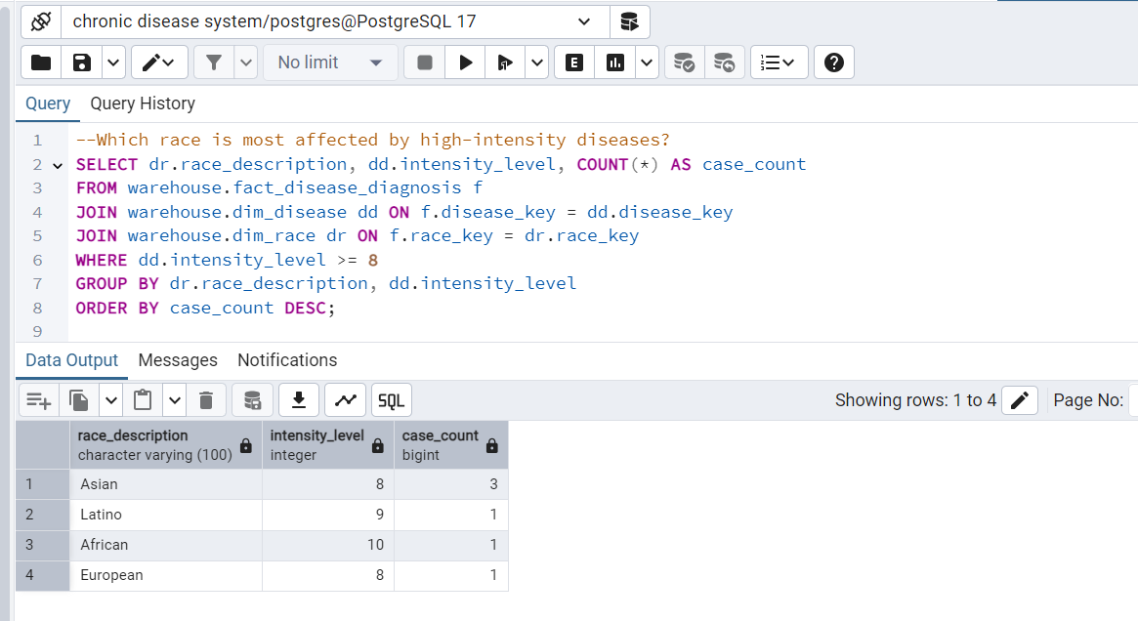
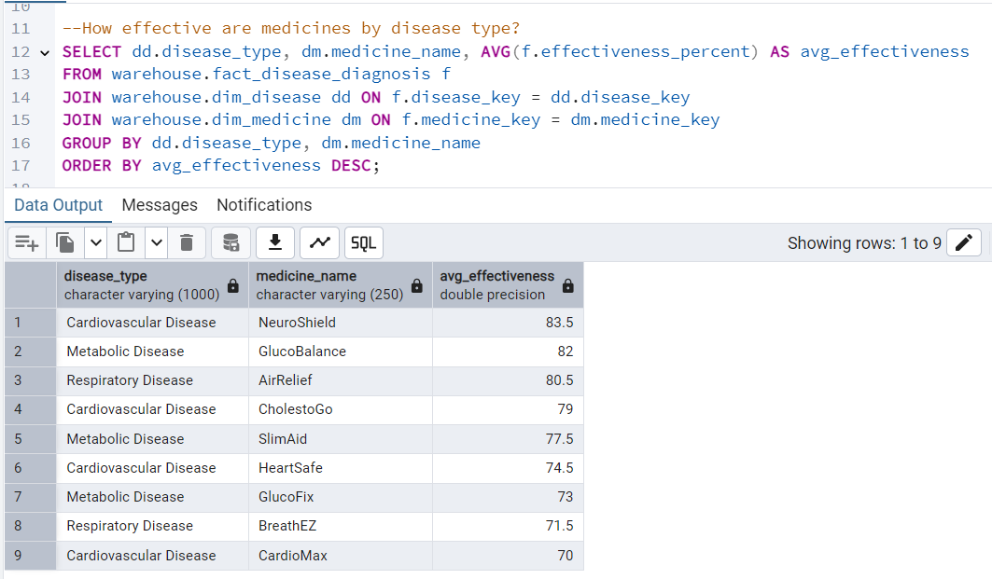
Analytical Queries
Which race is most affected by high-intensity diseases?
How effective are medicines by disease type?

Slide 24
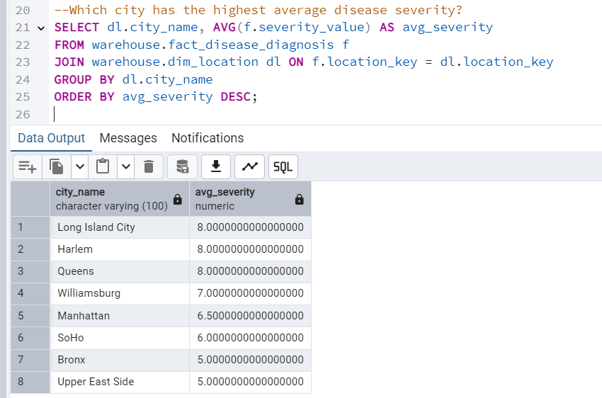
Analytical Queries
Which city has the highest average disease severity?

Slide 25
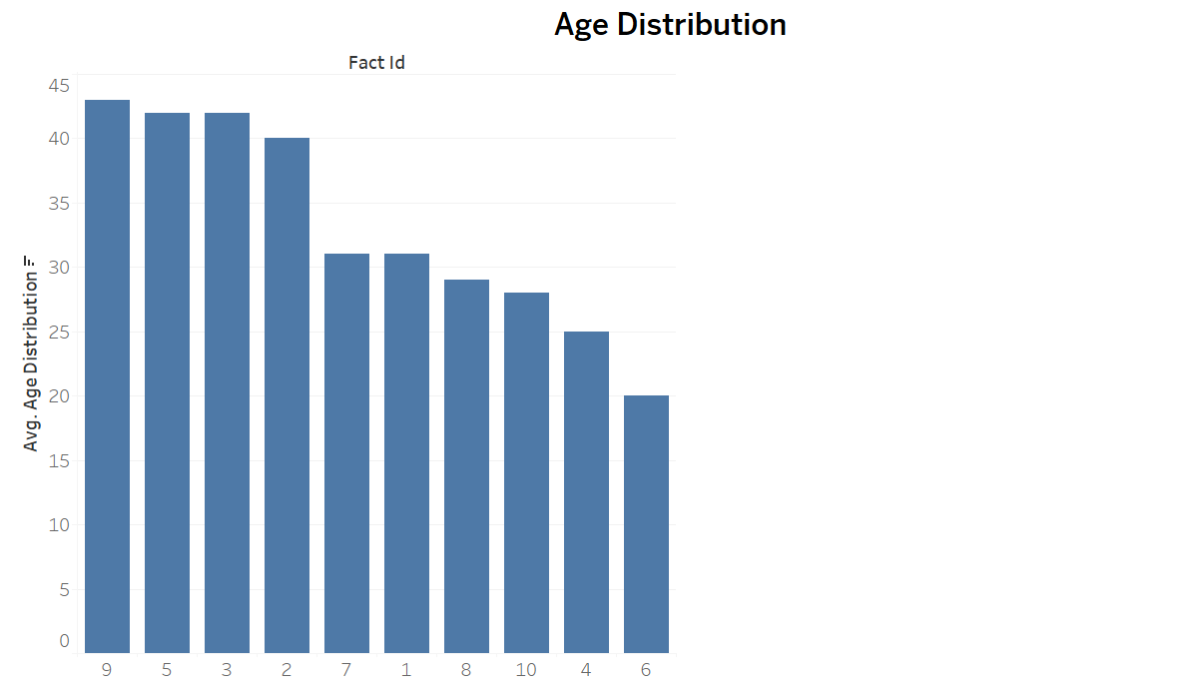
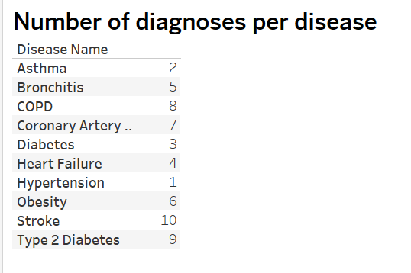
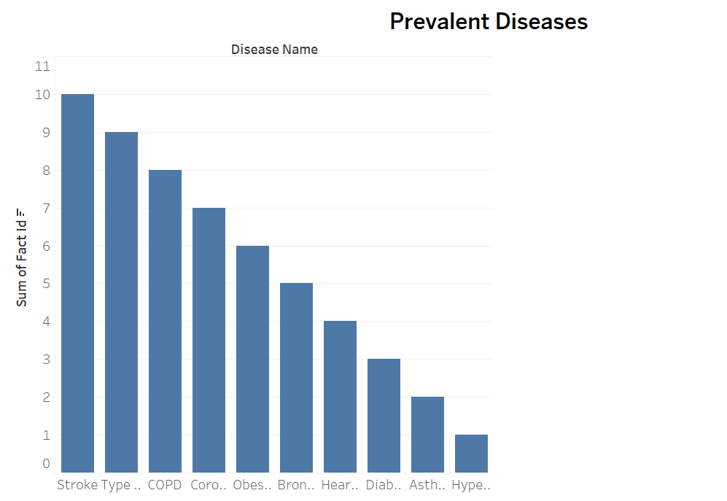
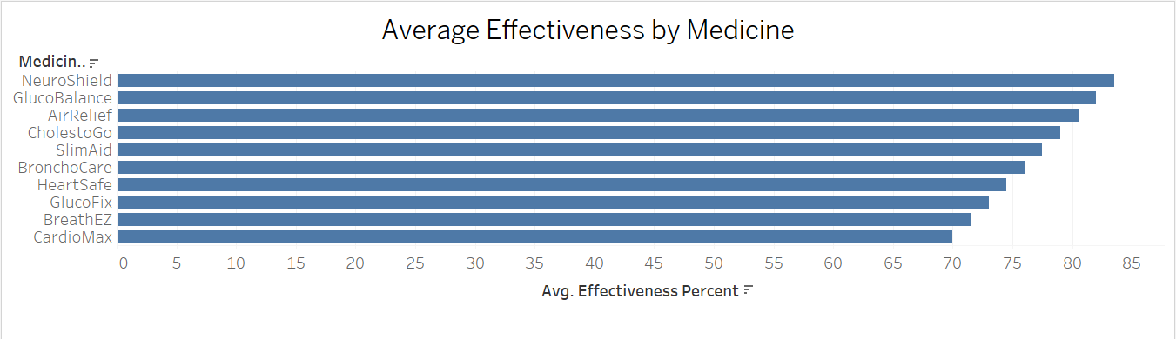
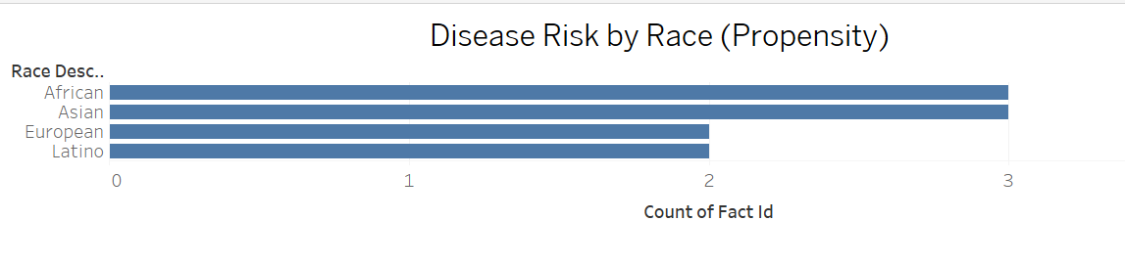
Analytical Visualizations

Slide 26
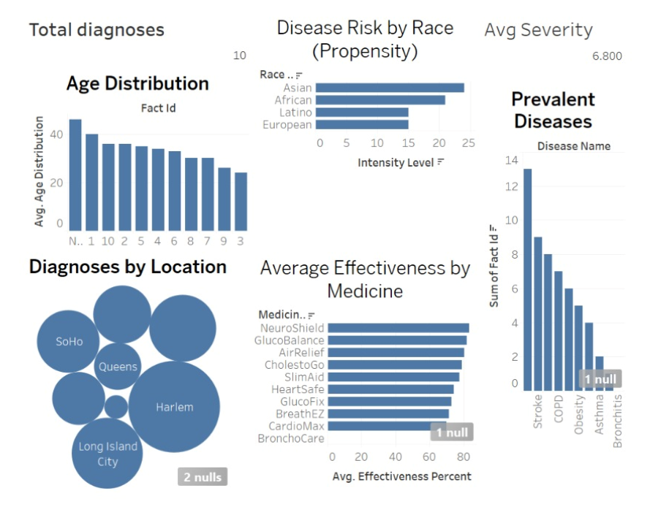
Analytical Dashboard

Slide 27
Key Analysis Capabilities:
The analytical dashboard we built from the dimensional data model brings the business problem to life by visualizing the following key insights:
Age Distribution : We can see how different age groups are affected by diseases, helping tailor prevention
and treatment strategies.
Disease Risk by Race (Propensity) : This highlights which racial groups show higher diagnosis counts,
pointing to potential health disparities or genetic susceptibilities.
Prevalent Diseases : We identify which diseases dominate across our population, focusing healthcare
priorities.
Diagnoses by Location : We can monitor geographic patterns, pinpointing hotspots like specific cities or
regions, which supports resource allocation.
Average Effectiveness by Medicine : This shows how effective treatments are across disease types,
supporting evidence-based decisions on therapy and medication.

Slide 28
Business value
These visual insights help healthcare providers and policymakers make data-driven decisions, such as targeting at-risk populations, improving treatment protocols, and allocating funding where it’s needed most.

Slide 29
Note on the Data
The entire dataset used in this project is synthetic (artificially generated).
It was created solely for the purpose of demonstrating the analytical capabilities of the system.
The values you see in the queries, dashboards, and visualizations are not real-world clinical data — they are mock data designed to simulate realistic patterns and allow us to showcase how the database and analytical tools function.
This approach allows us to test and illustrate how insights can be drawn across demographics, disease patterns, and treatment outcomes

Slide 30
Documentation: NoSQL vs Relational Structure
Relational (Postgres) Database:
Structured tables with strict schemas (patients, diseases, medicines, etc.).
Data is normalized to reduce redundancy.
Uses foreign keys and joins to connect related data.
Example: Patient details are stored in dim_person, disease details in dim_disease, and linked via fact_disease_diagnosis.
NoSQL (MongoDB) Database:
Data organized in collections and documents.
Schema is flexible; documents can vary and embed related data.
Denormalized design: a single document might store patient, disease, and treatment data together.
Avoids joins; designed for fast reads and scalable storage.
Key Contrast: Relational focuses on consistency and structure; NoSQL prioritizes flexibility and speed.

Slide 31
In Neo4j
data is modeled as nodes and relationships.
This structure is ideal for complex relationships and graph-based queries.
For example:
(:Person)-[:HAS_DISEASE]->(:Disease)
(:Disease)-[:TREATED_WITH]->(:Medicine)
(:Person)-[:LIVES_IN]->(:Location)

Slide 32
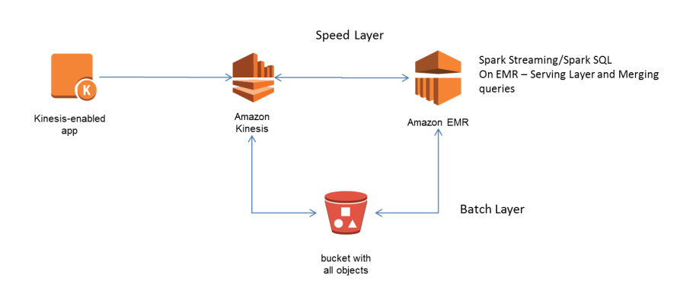
Architecture and Process in AWS
Batch + Real-Time Lambda Architecture:
Batch Layer: Store raw data in S3, process with AWS Glue or EMR, load into Redshift or RDS Postgres.
Speed Layer: Capture real-time events (e.g., new disease cases) using Amazon Kinesis; process updates instantly with AWS Lambda.
Serving Layer: Serve analytics via Amazon QuickSight, with optional Redis Elasticache for fast query responses.
Resilience: Multi-AZ deployments, automated backups, failover configurations.
Security: IAM permissions, VPC isolation, encryption, CloudTrail logging.
Performance: Auto-scaling, serverless compute (Lambda), and caching layers ensure efficient, high-throughput operations.

Slide 33
Snowflake Advantages for Our Application
Separation of Compute & Storage: Scale compute resources without impacting storage costs.
Fully Managed Service: No manual tuning or infrastructure management.
High Concurrency: Automatically handles many simultaneous users and workloads.
Native Semi-Structured Data Support: Easily load and query JSON, Parquet, Avro formats alongside structured tables.
Advanced Features: Time travel (query past snapshots), secure data sharing, and collaboration across organizations.
Summary: Snowflake offers greater scalability, ease of management, and advanced analytics capabilities compared to a traditional Postgres-based warehouse, making it ideal for growing, data-intensive healthcare analytics applications.

Slide 34

Thank You

